Slide 1
Azure BeerOps

Slide 2
Attention
MMS sessions are 60-75 minutes followed by LONG Q&A
Please hold detailed questions until that Q&A starts
Feel free to ask clarification questions
Remind the speakers to use Zoom It when you can’t see

Slide 3




Scott Corio
Donnie Taylor
Microsoft MVP, Brewer
Microsoft MVP, Sorta-Brewer
dumpsterdave
in/scottcorio
donnietaylor
in/donnietaylor

Slide 4

Nathan Ziehnert
Microsoft MVP, Destroyer of Kegerators
theznerd
in/nathanziehnert

Slide 5
Know Before You Show (up to our session)
We assume that you will have a strong grasp on the following concepts:
Beer > Water
Azure > On-Prem > AWS
It will help (but is not required) to understand:
APIs (Alcohol Production & Ingestion)
REST APIs (APIs while you sleep)
DNS (Donuts, Not Strudels)
KQL (Keg Query Language)
Postman (The one with Kevin Costner)
Raspberry Pi (When you can’t get apple or cherry)

Slide 6
Some Things You’ll Learn
What is Beer?
How do we make beer?
What does Azure have to do with beer?
How do we leverage Azure to make better beer?
How can I utilize these same concepts for, say, Home Assistant?
Why would I use Azure for home/personal projects?
How can I play with Azure on the cheap or free?
How do I make sure it stays cheap (or free)?

Slide 7
What is Beer?
Water + Malted Barley + Hops + Yeast = Beer
Hot water is mixed with crushed grain which converts the starches into fermentable sugars
The wort is drained and then boiled with hops to extract the oils, alpha acids, concentrate the sugars, and boil off DMS
Wort is then chilled and yeast added which converts the sugar to alcohol
Yeast eats sugar, poops alcohol, and farts carbon dioxide
Enjoy your yeast poop!

Slide 8
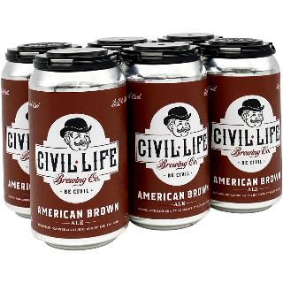
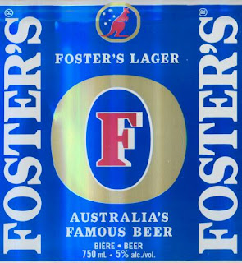
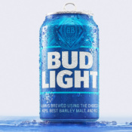
What is Beer?
Beer
Beer (Australia Only)
Not Beer

Slide 9
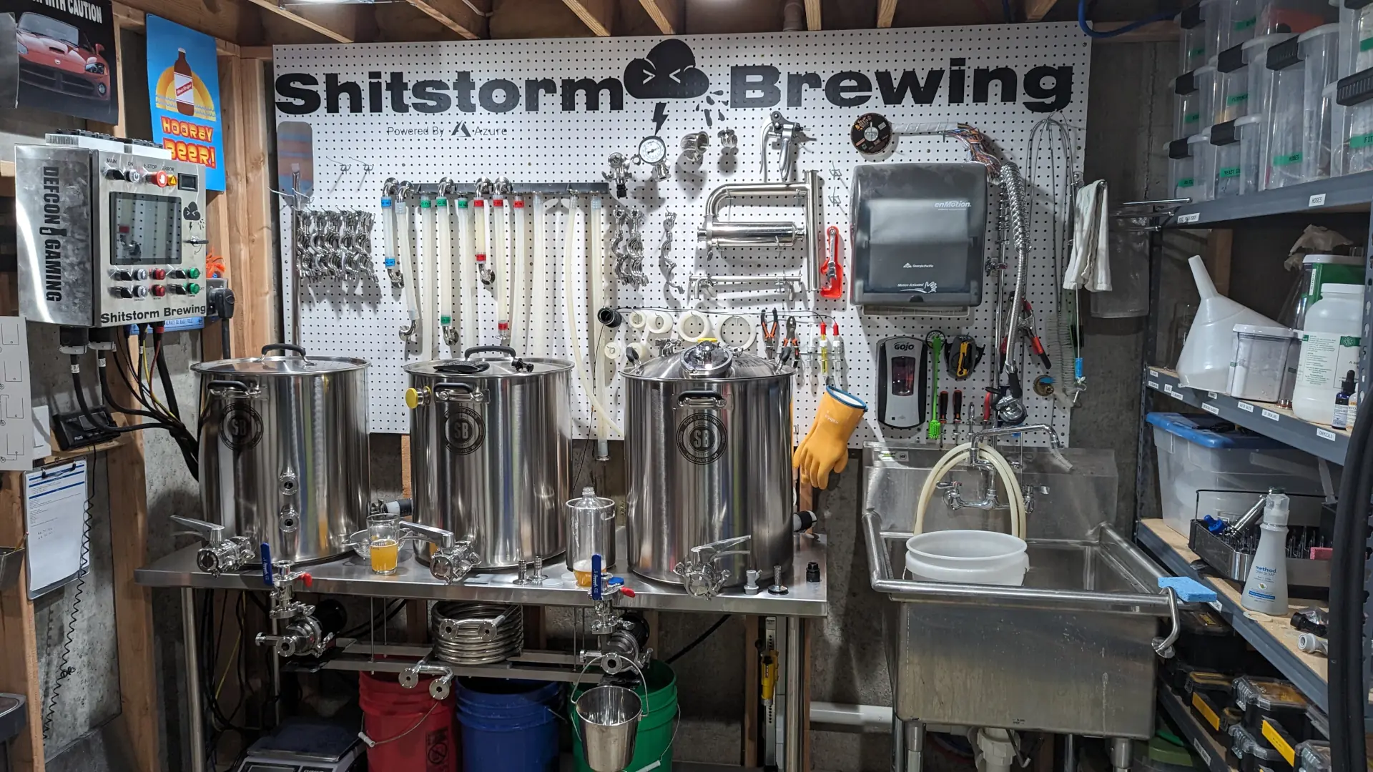
How do we brew beer with Azure?

